Slide 1
Lectures 15 & 16 – Designing a computer
2017.09.25 and 2017.09.27
King: Young Lady, look along the road and tell me if you can see either of my messengers.
Alice: I see nobody on the road.
King: I only wish I had such eyes. To see nobody, at such a distance, too! It's enough for me to see real people by this light.
from Through the Looking-Glass, and What Alice Found There
by Lewis Carroll (Charles Lutwidge Dodgson), 1871.

Slide 2
Assignments
Read chapter 6
Lab 04 this week

Slide 3
Announcements
Midterm 1 complete; scanned tomorrow; discuss Wed.
Final Exam time and place: Monday, Dec. 11 10:30am to 12:30pm in STEW 183 a.k.a. Loeb Playhouse
a.k.a. – also known as

Slide 4
Design a Simple Computer
We are moving up the levels of abstraction in the computing platform
“Bare metal” computer :=: Arithmetic and logic unit (ALU), Multiplexers, Registers, Memory
Function units :=: full adder, decoder, flip-flop
Logic device :=: gates
Electronic device :=: transistor
This follows the trend in abstraction from Lab 01 to 02 to 03
Notes:
Transistor
Gate
Adder, Flip-Flop
Arithmetic Logic Unit; Register; Memory
LOAD (memory referencing instruction) and ADD (register referencing instruction) shows the bleed through between levels of abstraction (HW to SW): If HW wasn’t such a WIMP then all memory would be as fast as registers and as fast as the ALU and ADD would reference MEMORY directly instead of a proxy for memory (in very early computers this was what happened).

Slide 5

Components of a computer
Useful decomposition of computer components for design considerations: input and output (I/O), memory, and data path and control (processor)
Key design quality concerns: user, delight, translation, performance
Performance
Evaluation
Program Translation
Processor
Memory
Instructions
Input
User
Control
←Operands
Results →
Output
Delight
ALU

Slide 6
Necessary basics
Input – cannot compute without telling computer what to do
Output – cannot know what computer did without output
Operations – execution is about performing operations
Programmed decision making – execution is much more powerful if the computer can make decisions

Slide 7
First focus – the data path (Chapter 6)
Design a circuit to perform
1) Fetch an instruction
2) Read operands from specified location(s)
3) Execute the instruction
4) Write the result into specified location
5) Repeat the above

Slide 8
Good design practice: 1 step at a time
Design requires considering options, making trade offs
Dividing a system design into a collection of subsystem design tasks is helpful
Data path circuit must accomplish 4 tasks, so start with Task 1: Fetch instruction
For a stored program computer, Fetch must mean “read from memory”
instruction means a bit string to interpret using the instruction format
will abbreviate instruction as instr.

Slide 9
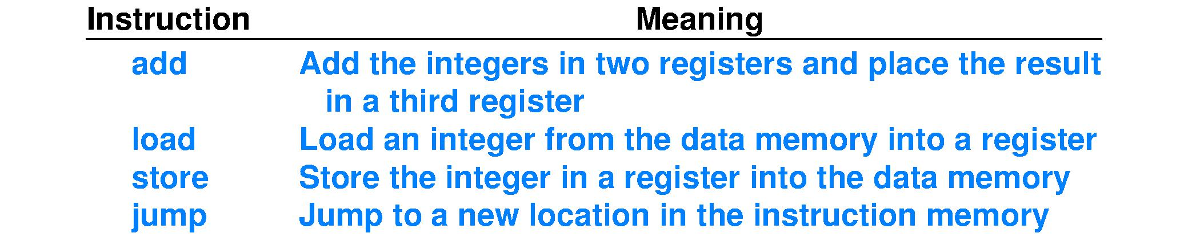
Choose the instruction set
Chapter 6, Fig. 6.1 develops an instruction set of four operations (tiny, instructive example)
Note: add operands and result come from/go to registers
load and store copy between registers and data memory
data memory implies Harvard-style instruction set architecture (ISA)
load and store are elements of instruction set because today’s main memory technology is much, much slower than NAND-based circuits
jump supports code sequences other than purely sequential, or straight line

Slide 10
Assembly language program
Assembly language expresses programs using the instruction set of the processor
Assembly instr. ; Comments load r2, 20(r1) ; r2 ← Data_Memory[20+r1] load r3, 24(r1) ; r3 ← Data_Memory[24+r1] add r4, r2, r3 ; r4 ← r2 + r3 store r4, 28(r1) ; Data_Memory[28+r1] ← r4 jump 60(r7) ; fetch at Instr._Memory[60+r7]
• r1, r2, r3, r4, r7 are registers; they store bit strings • “x ← y” means “x” receives the result of y • Memory[x] denotes the contents of memory at address x • 20, 24, 28 are immediate values encoded into an instr.; here they serve as an offset, an amount to add to a memory address held in a register (pointer arithmetic)

Slide 11
Assembly code is for humans
Example assembly instruction add r4, r2, r3
Bit string for add r4, r2, r3 in ASCII is 0x6164642072342C2072322C207233
Contains 28 0x digits, or 112 bits: so many hardware wires
Contains characters to aid human readability – spaces and commas – not needed as inputs to a logic circuit
Contains mnemonics to aid human readability – add, rX – unnecessary for logic circuit
An assembler maps, different from compiling, instrs. onto a representation better-suited for logic circuit inputs
Assembly language has a 1-to-1 correspondence to voltages on wires in the processor hardware circuit
Notes:
Seeing “Nobody” in the instruction: unused offset field.
Circuit must be designed to ignore content of this field for the ADD instruction.

Slide 12
Define the instruction representation
Chap. 6 example develops 4 instructions, but let’s imagine that our little computer
has 32-bit instructions, 32-bit default integer size, and 32-bit memory addresses (when each of these important bit strings is the same size, the processor circuit is simpler, faster)
has up to 32 instructions
has 16 registers used to store operands and results
has immediate value integers with largest range
These four design choices are enough to fully define the instruction representation, or format

Slide 13
How the design choices set the format
“32-bit instructions” = instr. format is 32 bits
Opcodes are 5 bits because
“Up to 32 instructions” requires sufficient opcode bits to name ≤ 32 ≤ 2⁵, so 5 bits is enough
>5 opcode bits would deprive immediate integer operands of bit(s) and, thus, range
Register addresses are 4 bits because
4-bit addresses can point to 16 locations
Immediate values have all remaining bits
largest range of immediate values, implies “give all remaining bits in the format to immediate values”

Slide 14
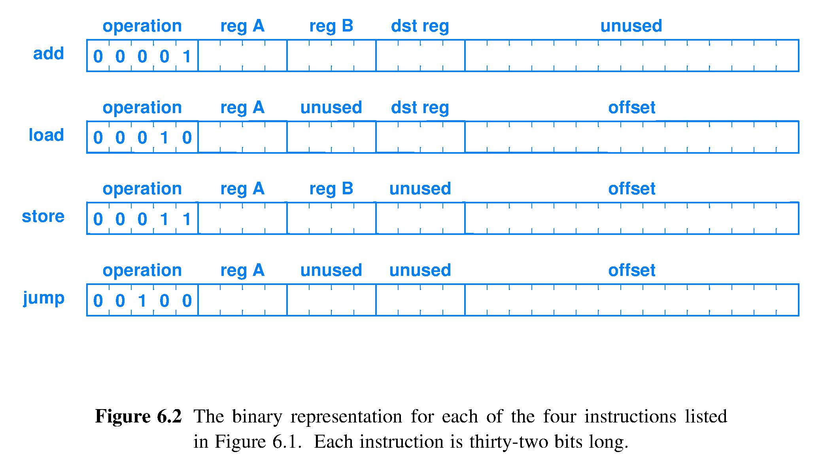
Instruction format example
Preceding translates to this format, ordering of fields within the bit string is a design choice
______ _____ _____ _____ ______________________ 5 bits 4 bit 4 bit 4 bit 15 bits (all the rest)

Slide 15
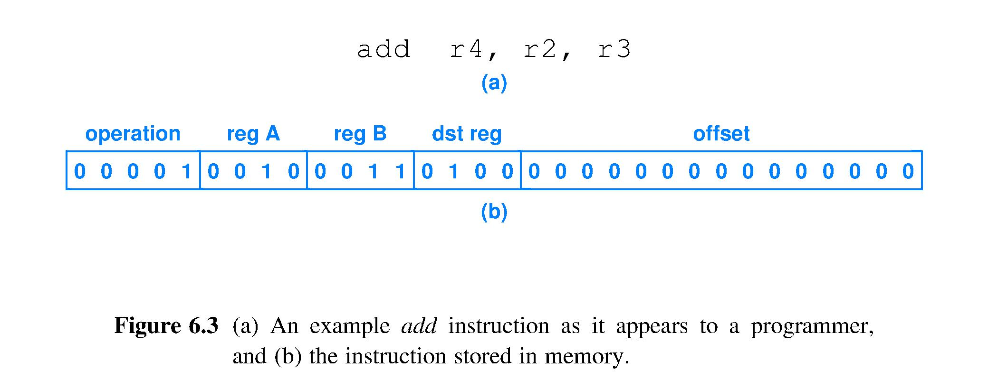
Assembly code to machine code
Consider this integer addition assembly language instruction add r4, r2, r3 ; r4 ← r2 + r3
The assembler will map this character string to a machine language bit string in the chosen representational format, and the 1’s and 0’s correspond to voltages on wires in the circuit
Opcode PointerPointerPointer Unused offset, here set arbitrarily to all 0
Notes:
Seeing “Nobody” in the instruction: unused offset field.
Circuit must be designed to ignore content of this field for the ADD instruction.

Slide 16
Assembly to format correspondence
Assembly instr. ; Comments load r2, 20(r1) ; r2 ← Data_Memory[20+r1] load r3, 24(r1) ; r3 ← Data_Memory[24+r1] add r4, r2, r3 ; r4 ← r2 + r3 store r4, 28(r1) ; Data_Memory[28+r1] ← r4 jump 60(r7) ; Fetch at Instr._Memory[60+r7]
Corresponding instruction format representation load dst_reg, offset(reg_A) load dst_reg, offset(reg_A) add dst_reg, reg_A, reg_B store reg_B, offset(reg_A) jump offset(reg_A)
One-to-one correspondence of assembly to instruction format, but often order is permuted

Slide 17
Assembly to pseudo-machine code
Assembly instr. ; Comments load r2, 20(r1) ; dst_reg, offset(reg_A) load r3, 24(r1) ; dst_reg, offset(reg_A) add r4, r2, r3 ; dst_reg, reg_A, reg_B store r4, 28(r1) ; reg_B, offset(reg_A) jump 60(r7) ; offset(reg_A)
Corresponding pseudo-machine code representation: still has X = don’t care for unused fields (Spaces are only for readability, Dreg = dst_reg) Opcode regA regB Dreg Offset 00010 0001 XXXX 0010 000000000010100 00010 0001 XXXX 0011 000000000011000 00001 0010 0011 0100 XXXXXXXXXXXXXXX 00011 0001 0100 XXXX 000000000011100 00100 0111 XXXX XXXX 000000000111100

Slide 18
Actual machine code
Assembly instr. ; Comments load r2, 20(r1) ; dst_reg, offset(reg_A) load r3, 24(r1) ; dst_reg, offset(reg_A) add r4, r2, r3 ; dst_reg, reg_A, reg_B store r4, 28(r1) ; reg_B, offset(reg_A) jump 60(r7) ; offset(reg_A)
Machine code showing one choice for values of X’s 00010000111110010000000000010100 00010000100000011000000000011000 00001001000110100101010101010101 00011000101000011000000000011100 00100011110011001000000000111100
These five 32-bit strings are how the processor sees this program: a sequence of 5 collections of 32 voltage levels

Slide 19
Where are instructions stored in memory?
Memory is a 1-dimensional (1-D) array of storage locations, one location after another, sequential
Programs are sequences of statements, 1-D
Simplest storage strategy:
Store instructions in sequential memory locations
Performance evaluation:
Computing the address of the next location in a sequence requires only adding a fixed increment to the address of the current location [simple and fast]
Next location function must be able to create any 32-bit address, so can call a subroutine located anywhere

Slide 20
Lectures 15 & 16 – Designing a computer
2017.09.25 and 2017.09.27
King: Young Lady, look along the road and tell me if you can see either of my messengers.
Alice: I see nobody on the road.
King: I only wish I had such eyes. To see nobody, at such a distance, too! It's enough for me to see real people by this light.
from Through the Looking-Glass, and What Alice Found There
by Lewis Carroll (Charles Lutwidge Dodgson), 1871.

Slide 21
Assignments
Re-read chapter 6
Lab 04 this week
Read chapters 7 and 9

Slide 22
Announcements
Midterm 1 scanning starts tomorrow; discuss Fri.
Lecture canceled because Midterm #2 is an evening exam: Monday, Nov. 20
My office hours are rescheduled, same number
W 10:00am - 11:00am in HAAS 122 (MR at this time deleted)
MW 2:20pm - 3:20pm in MATH 175 (F at this time deleted, due to CS department meeting schedule)
R 2:00pm - 6:00pm in HAAS 122 (starts 2 hours earlier)
M 4:30 - 5:30pm and W 4:30 - 6:00pm in HAAS 122 (M time added)
By appointment for other times or a private meeting.

Slide 23
Time to: 1) Fetch instruction
Instructions are in memory; fetch one means Processor_control ← Memory[address of instr.]
Need circuit that can hold and output a 32-bit address to instruction memory: 32-bit register
Memory is addressed byte-by-byte
Fetch one instruction means give memory circuit address of first byte and have hardware designed to provide that byte followed by next 3 bytes
Thus, following 32-bit instr. will start at byte address = Current instruction address + 4

Slide 24
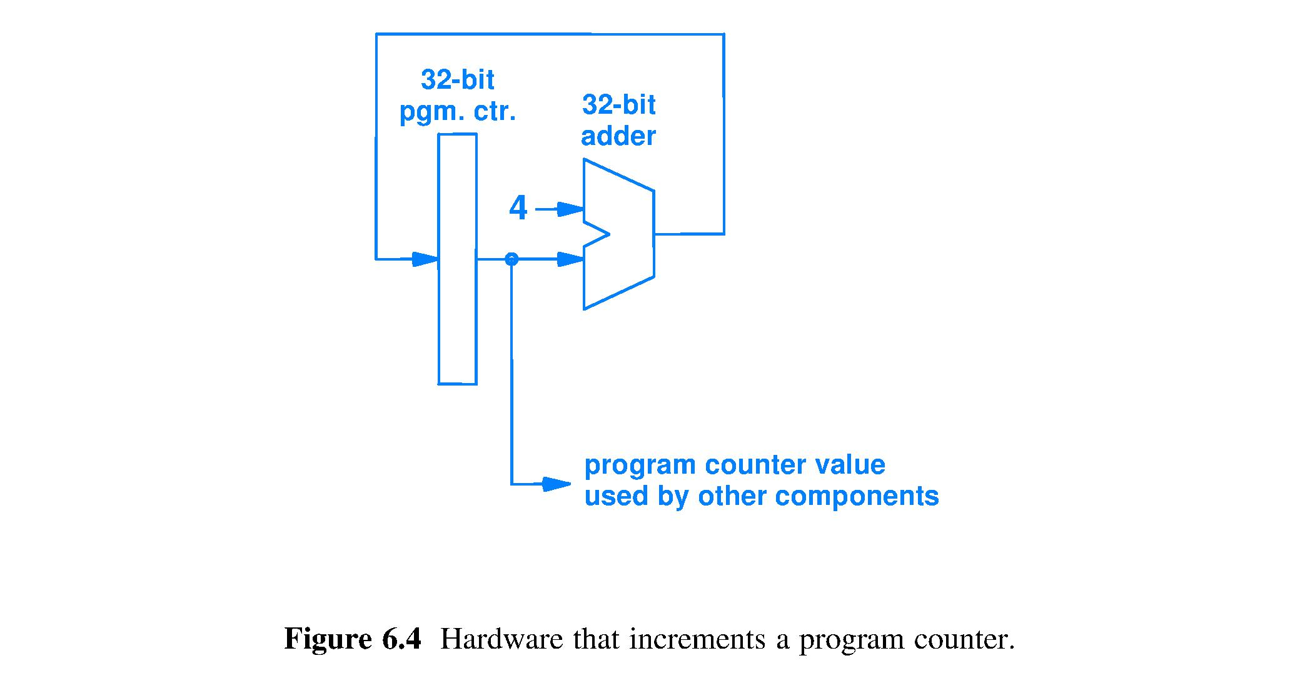
Fetch circuit – automating straight-line code
Register that holds Current_instruction_pointer (address) to the location in memory of the instruction to be fetched, also known as the Current Instruction
32 wires carrying the value Current_instruction_pointer + 4, also known as the Default_next_instruction_pointer
32
/
32
/
32
/
32
/
Symbol for integer adder circuit
Amount to add to point to the next instruction, given the design choice of a fixed-size, 4-byte long instruction format AND byte-addressed memory
32
/
This symbol actually represents many wires much of the time (abstraction). For clarity, when needed, we add a label showing the number of wires.
32 wires that connect to the address input of instruction memory
Notes:
There are no explicit types in hardware; you have to figure out the data type by context and thinking.

Slide 25
Fetch circuit is a sequential circuit
Combina-torial logic,
32-bit
integer adder
State register
Register
Clock
Clock
Program counter, which functions as the Current_instruction_pointer
Orange used to show information abstracted out of Chapter 6 figures
Fetch uses history (previous fetch location) to determine where to fetch next: sequential

Slide 26
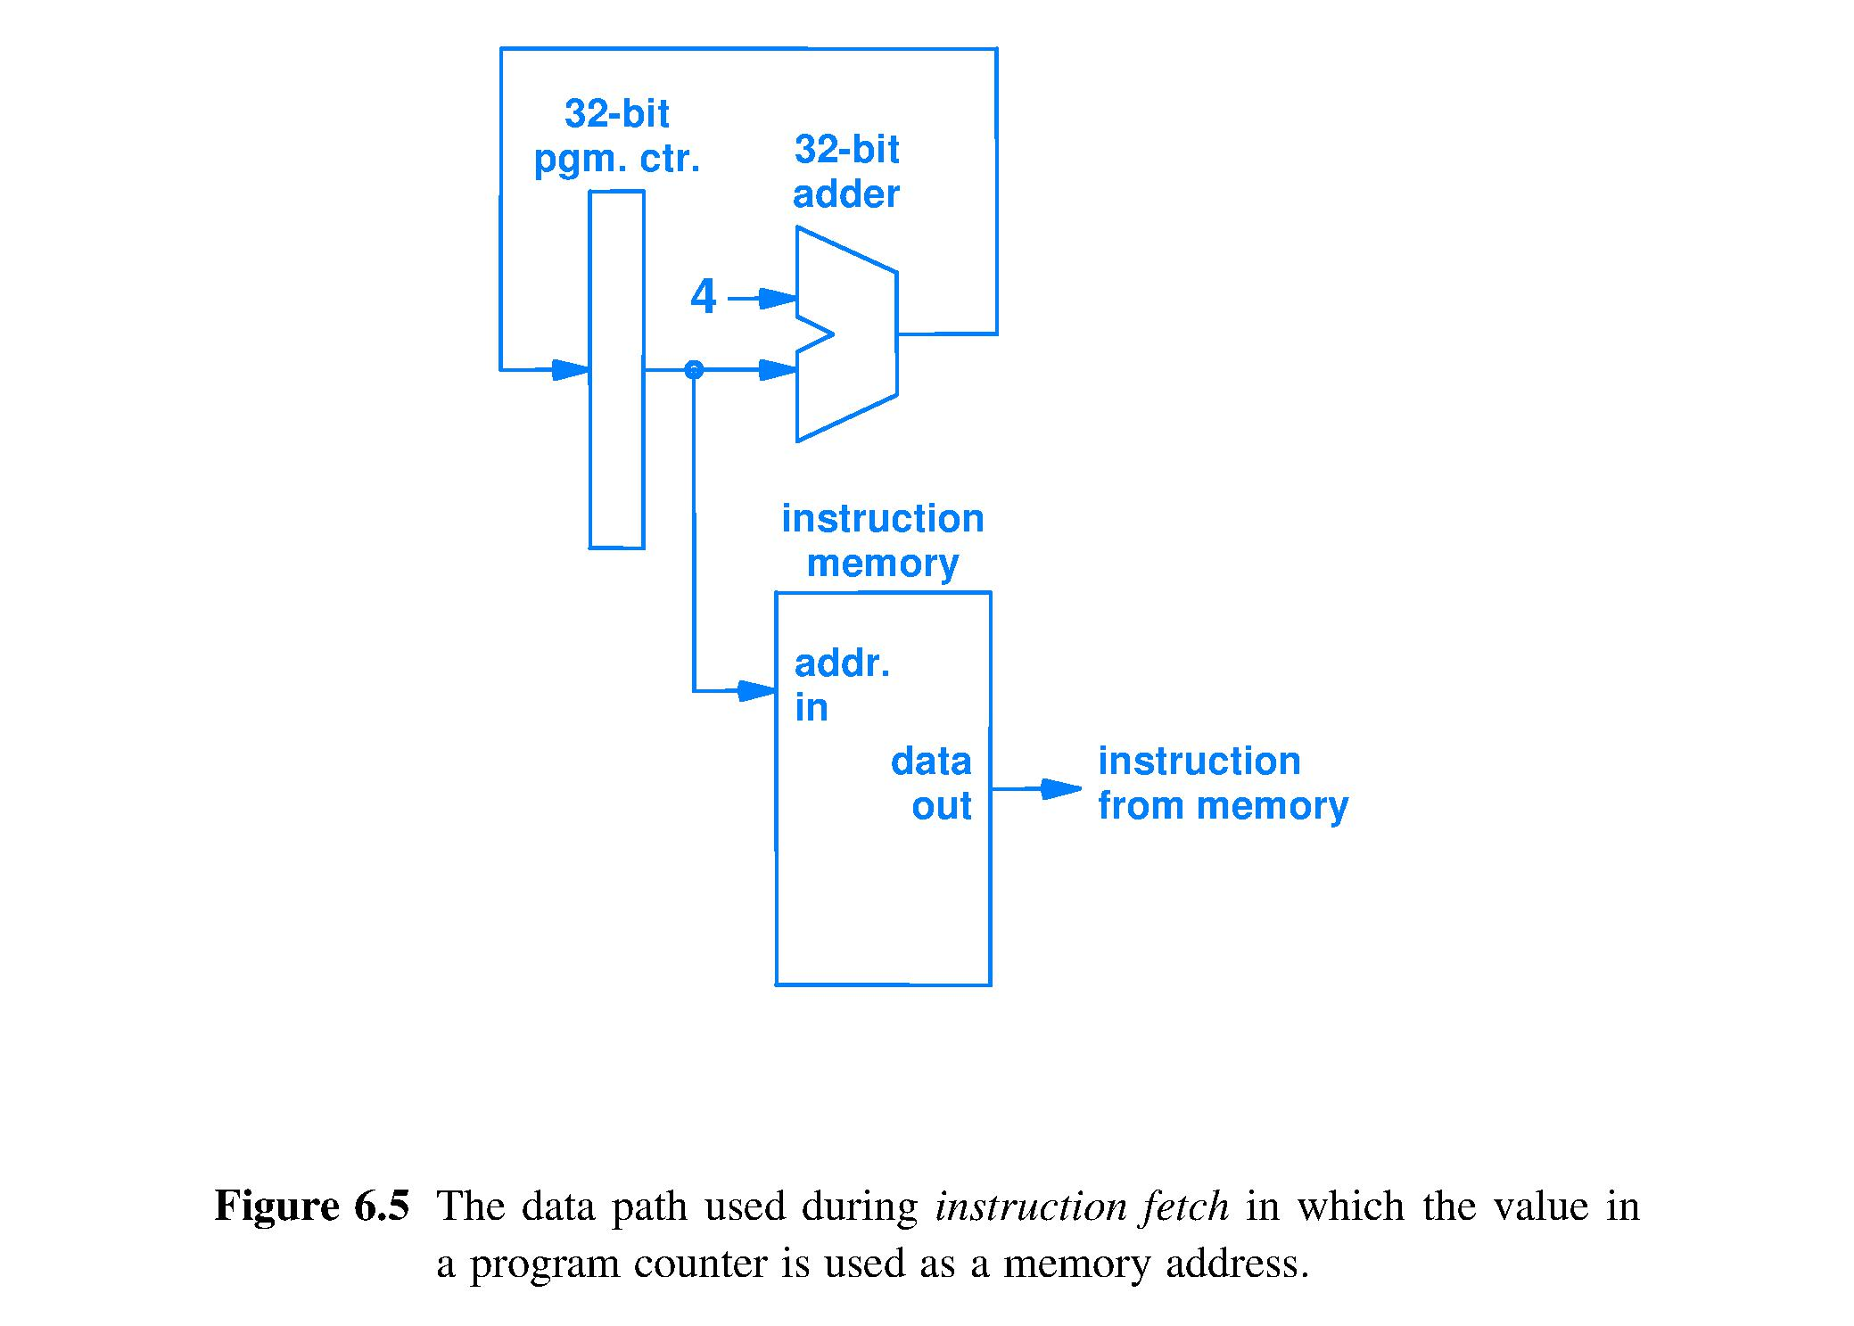
Connect fetch to instruction memory
Get a copy of the bit string at the location pointed to by address_in.
Send bit string to be interpreted as an instruction
Instruction memory input is a pointer, a bit string to be interpreted as an address

Slide 27
Build processor control – decode instr.
Decoding an instruction means to
Interpret all fields of instruction format and
Generate logic signals to tell the data path circuit what to do (control the data path)
A well-chosen instruction format makes decoding cheaper (simpler circuit) and faster
Very easy decoding for our textbook example, just partition the bit fields of the format

Slide 28
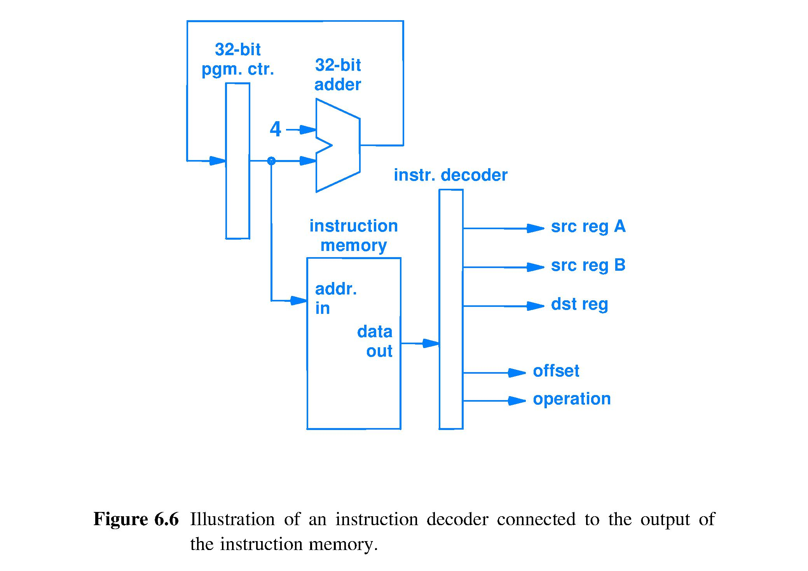
Decode for the example processor
Constant
Pointer
32
/
32
/
32
/
32
/
Bit string from Instruction_Memory Data-Out wires is decoded by grouping wires according to the instruction format fields. Most instruction sets are more complex to decode.
Wire group functions are:
• Pointing (3 instances, 4 bits each) • Value delivery (offset, 15 bits) • Operation selection for arithmetic/logic unit (ALU) (another pointer, 5 bits)
4
/
Pointer
Instruction
4
/
Pointer
Address, or pointer
Pointer, or address
4
/
Pointer
32
/
Value, constant
15
/
/
5
Control, selects operation (points)

Slide 29
Time to: 2) Locate and read operands
Instruction memory provides one instruction per fetch
Instructions need up to three accesses to memory
For speed of execution, want memory that supports three, independent simultaneous accesses; need not be a large # of locations
Today’s technology’s solution is the register unit, a.k.a. the register file
A small collection of registers, each sized to hold the default size integer and address bit string

Slide 30
Time to: 2) Locate and read operands
Operands in the instruction format are
reg A, reg B, and offset which are, respectively
pointer, pointer, and immediate value
Pointer bit strings should be delivered to the address input(s) of the register unit, which in turn outputs bit string(s) that, if delivered to the arithmetic/logic unit (ALU), will be interpreted as operand(s)
Immediate value bit strings should be sent directly to the ALU

Slide 31
Register Unit details
Contains 16 32-bit registers
Inputs: 45 wires
Because 1 instr. may access reg A, reg B, and dst reg, need three 4-bit addresses [12 bits]
Write_Enable control signal (abstracted out, not shown in textbook figures) to enable storing a result when appropriate [1 bit]
Result value to be written [32 bits]
Outputs: 64 wires
Copies of the 32-bit contents of any 2 of 16 registers, including ability to duplicate contents of one register to both outputs
Register is the fastest memory technology available today; easily keeps up with computational, combinatorial circuits

Slide 32
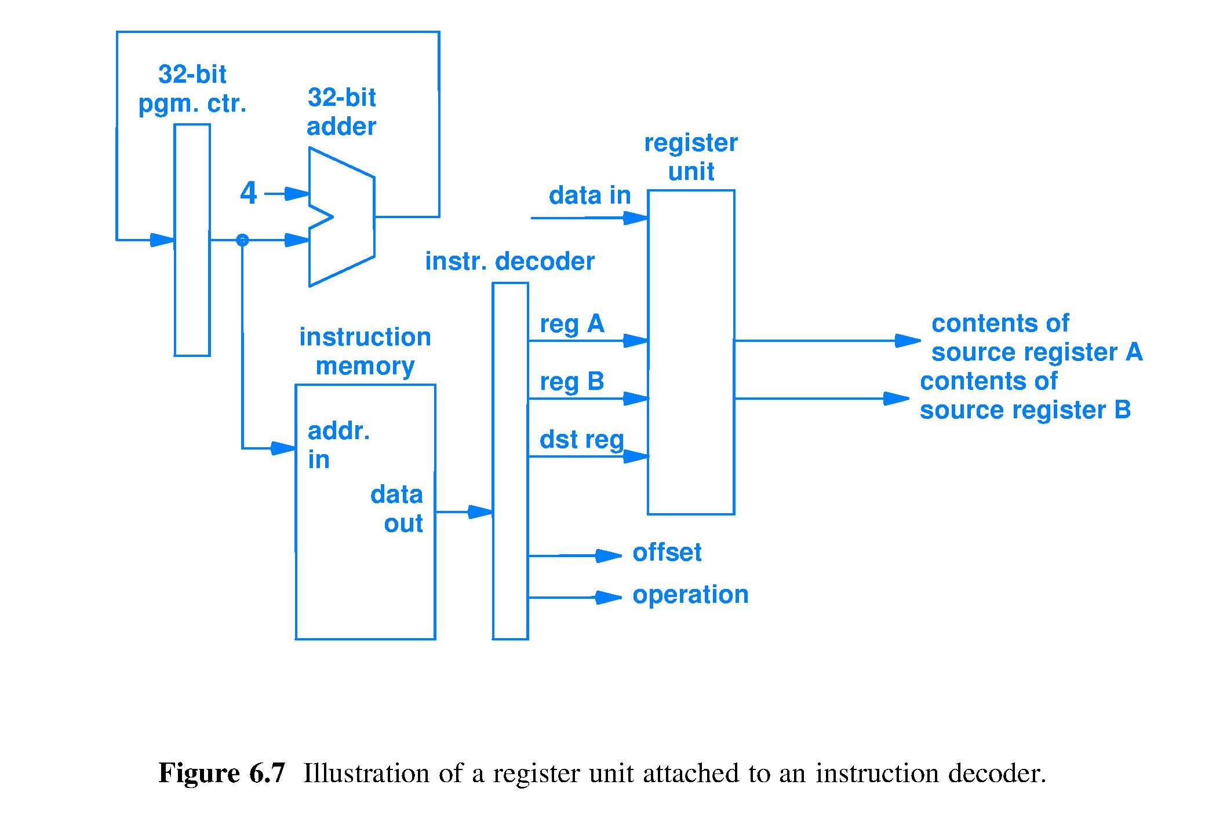
Read operands, completing Fetch
Copy of
15-bit value direct to ALU
5 bits of control signals (pointer) direct to ALU
Notes:
Use thought question #1, #2, #3, and #4 here.

Slide 33
Time to: 3) Execute instruction
Execution circuit (ALU) supports all instructions
Instr Definition add dst_reg ← reg_A + reg_B load dst_reg ← Data_Memory[offset + reg_?] store Data_Memory[offset + reg_?] ← reg_? jump Fetch at Instr_Memory[offset + reg_?]
What does each instruction ask of the ALU?
add: add values sourced from reg A and reg B
load: add Offset and value sourced from Reg ?
store: add Offset and value sourced from Reg ? jump: add Offset and value sourced from Reg ?
Must design so that ALU can add for all 4 instr.

Slide 34
Design ALU input (operands) circuit
Textbook author’s design choice is implement add Offset and value sourced from Reg ? as Offset + reg A
Could have choosen Offset + reg B

Slide 35
Design ALU input (operands) circuit
Design question #1: How should we build the ALU input circuit so that the ADD instr. sends the selected operands reg A and reg B to the ALU, while the LOAD/STORE/JUMP instrs. send the selected operands Offset and reg A to the ALU?
Answer: use a MUX to select Offset or reg B as needed
Design question #2: What must the design include to permit sending the Offset to the ALU?
Answer: the 15-bit size of the Offset must be increase to 32 bits without changing the value of the Offset: sign extend

Slide 36
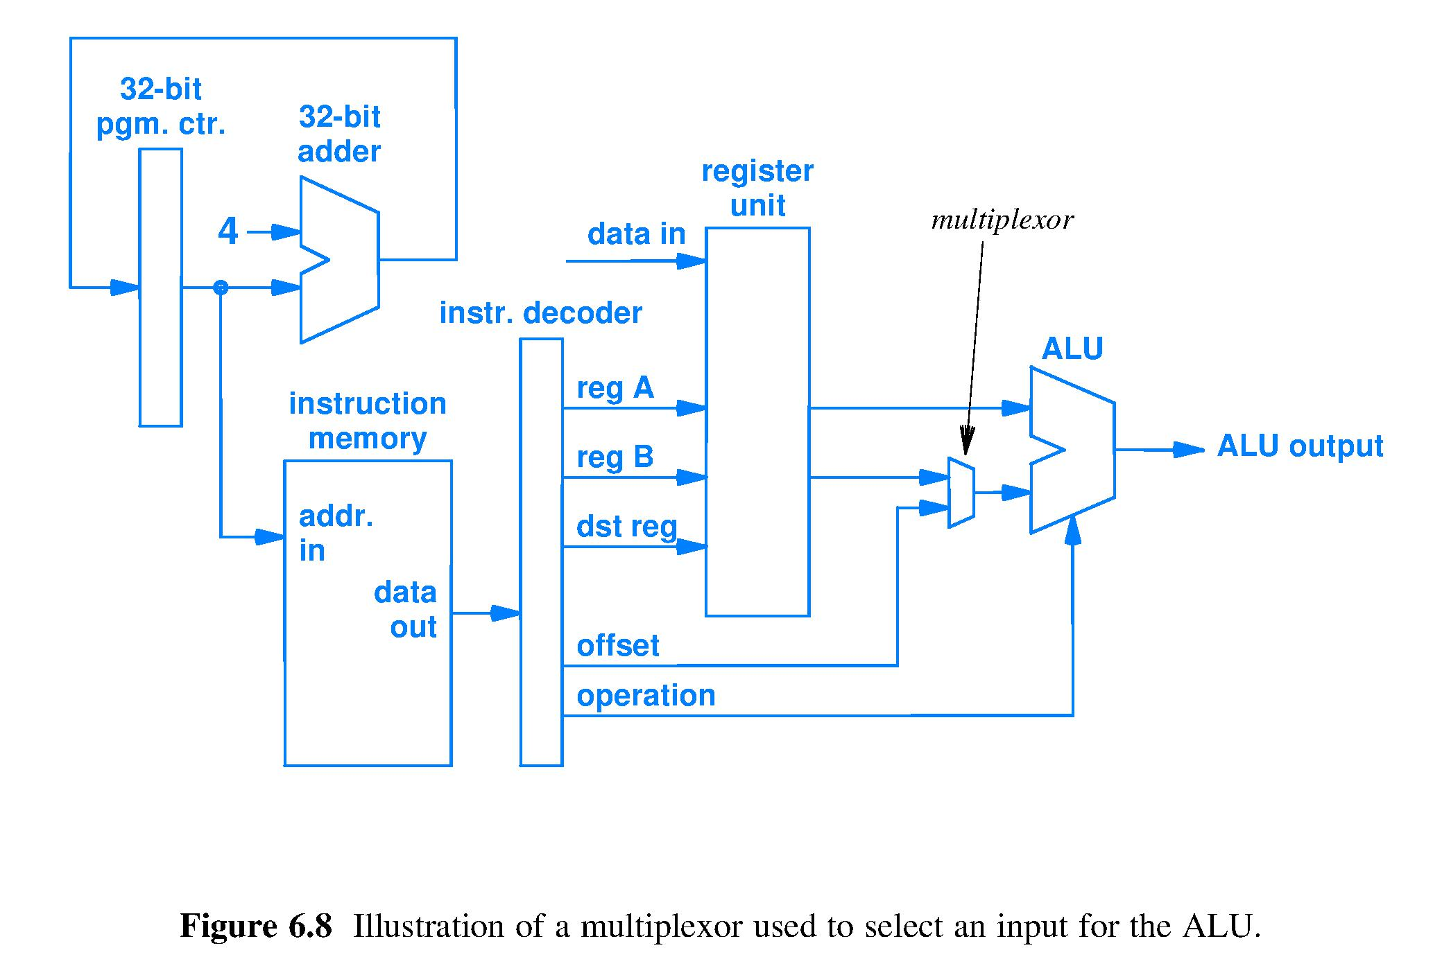
Arithmetic/Logic Unit (ALU) in action
Selected operand
reg A 32-bit value
reg B 32-bits
Opcode bits to control ALU
Sign extend
32-bit sign extended offset value
15 bit offset in 2’s comp
Mux circuit chooses 1 of 2¹ inputs to connect to ALU. Mux must receive a 1-bit signal controlling which 1 of 2¹ inputs is selected. Mux control input wire (1-bit pointer to sign-extended offset or to reg B) is abstracted out of diagram.

Slide 37
ALU has produced a result; what next?

Slide 38
Time to: 4) Write result into specified location
What are the results and where do they go?
ADD: ALU output is the result, deliver to dst reg
JUMP: ALU output is Next_instruction_pointer, must deliver to Instruction_pointer_register
LOAD: ALU output is pointer that must be send to data memory, which then produces copy of the location contents which, finally, must be written into dst reg
STORE: ALU output is pointer that must be sent to data memory along with the value from reg B to be written into the data memory location

Slide 39
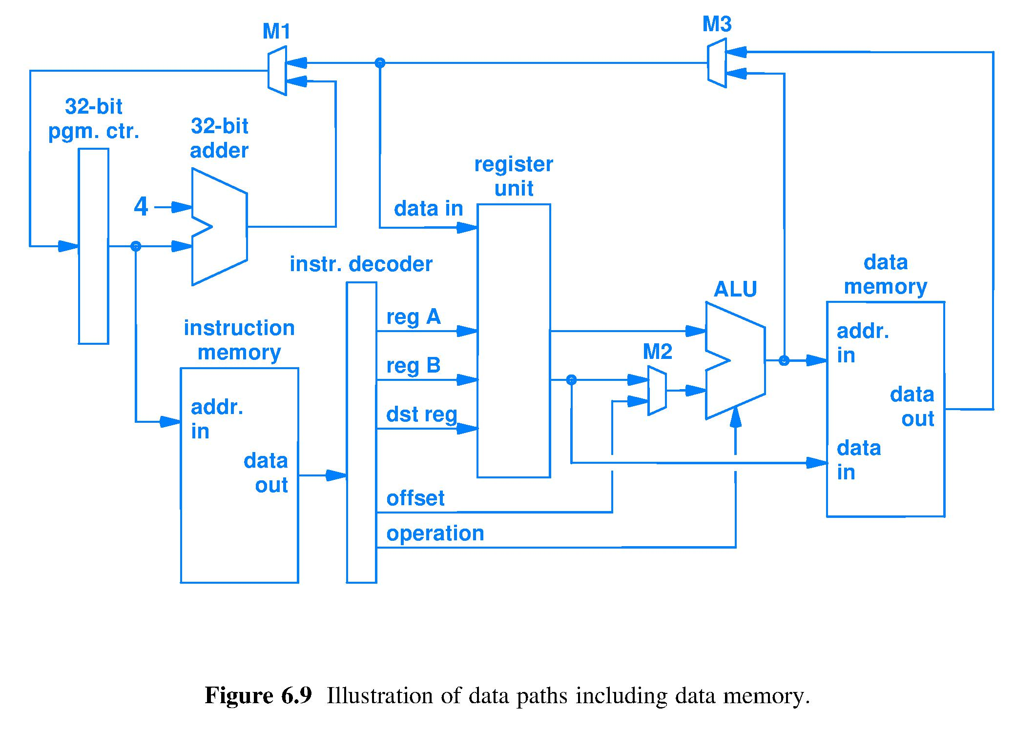
Put ADD result where it belongs
ADD result data path
ADD: ALU output is the result, deliver to dst reg. Result has the meaning “integer” because the integer adder was used; however, we cannot tell if the integer representation is unsigned or 2’s by looking at the voltages on the wires because the same adder circuit works with both formats.

Slide 40
Put LOAD result where it belongs
LOAD result data path
LOAD: ALU output is pointer sent to data memory, which then produces a copy of the location contents which, finally, must be written into dst_reg; Result is a bit string from memory: no inherent meaning.

Slide 41
Put STORE result where it belongs
STORE result data path
STORE: ALU output is pointer sent to data memory along with the value from reg B to be written into the data memory location. Result is a bit string from reg_B written in memory, where it has no inherent meaning.

Slide 42
Put JUMP result where it belongs
JUMP result data path
JUMP: ALU output is a computed Next_instruction_pointer, must deliver to Instruction_pointer_register. Result meaning is location of next instruction on the run-time execution path.

Slide 43
Result: Default_next_instruction_pointer
Default_next_instruction_pointer
Default_next_instruction_pointer is computed after every fetch because it is likely to be needed. Result meaning is location of sequentially_next instruction.

Slide 44
All result paths, overlapped
ADD result data path
JUMP result data path
LOAD result data path
STORE result data path
Input choices by Mux M3 and Mux M1 control where ADD, LOAD, and JUMP results are delivered (Mux control abstracted)

Slide 45
Figure 6.9 is fundamental
Learn the function of each wire and device, the number of bits anywhere, the data type of every bit string, and the operation of abstracted control circuitry and you will know the central processing unit (CPU) of a computer

Slide 46
Summary
A circuit that can fetch and execute instructions is programmable
The bits in machine code instructions control the operation of the data path; not all instruction format bit positions contain information for every instruction
Multiplexers route bits traveling on buses from hardware units to a hardware unit
Meaning of bits is set by the hardware unit (1) receiving the bits or (2) computing the bits

